Slide 1
Control Flow
Loops
Rajasekaran S
Assistant Professor,
Department of Information Technology,
KGiSL Institute of Technology,
email: proffraja@gmail.com
Github:www.github.com/rajasekaranap

Slide 2
Control Flow Statements
control flow (or flow of control) is the order in which individual statements, instructions or function calls of an imperative program are executed or evaluated.
Control flow statements, however, break up the flow of execution by employing decision making, looping, and branching, enabling your program to conditionally execute particular blocks of code.

Slide 3
Types Control Flow Statements
Control Flow
Decision Making
Looping
Unconditional Jumps
If - else
for
break
If – elseif - else
while
do-while
continue
switch
for-each

Slide 4
Loops
It is also known as iterate statements.
A block of code is repeatedly executed until some condition is satisfied or true.
There are 2 types of loops
Deterministic Loop
for loop
Non Deterministic Loops
while
do-while

Slide 5
FOR LOOP
For loop is also known as deterministic loop.
The loop contains
Initialization
Condition
Increment/Decrement
Using this we can clearly determine
String of loop.
When it will end
How many iteration may run

Slide 6
Syntax
for(Initialization; Condition; Increment/Decrement)
{
// Statements of for loop
}

Slide 7
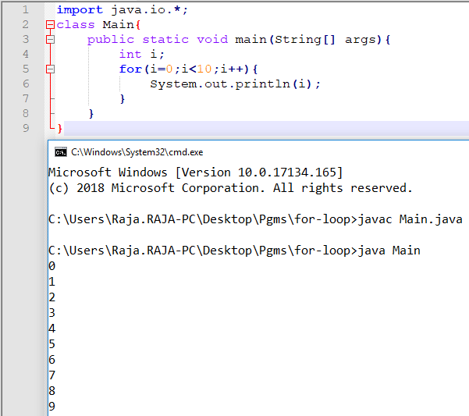
Example [Print 0 to 9]

Slide 8
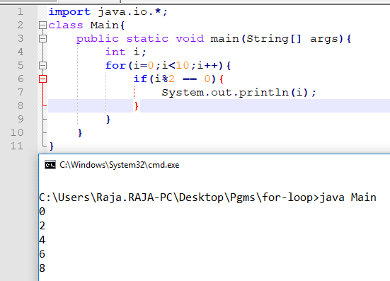
For with if [Printing Even Number]

Slide 9
WHILE LOOP
It is a type of non deterministic loop.
It check’s the condition before entering into the loop.
The block of statement repeatedly execute until the condition remains satisfied.
It is also known as entry control loop.
The condition may or may not satisfied.
We are not sure about the termination of loop and no of iterations.

Slide 10
Syntax
while(Condition){
…
// Block of while loop
…
}

Slide 11
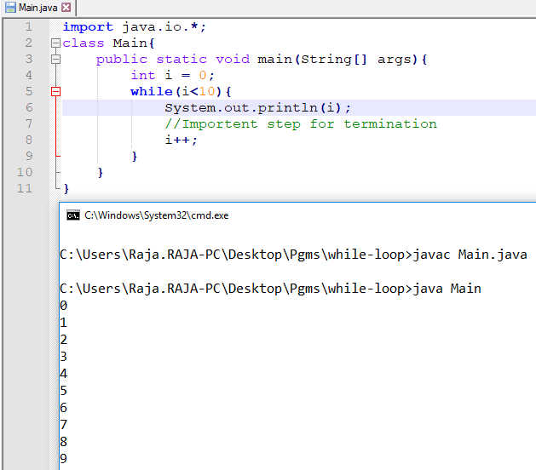
Example [Print 0 to 9]

Slide 12
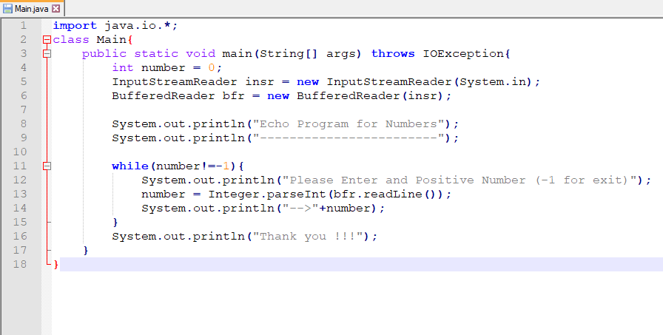
While loop vs User Input
Echo Program for Numbers

Slide 13
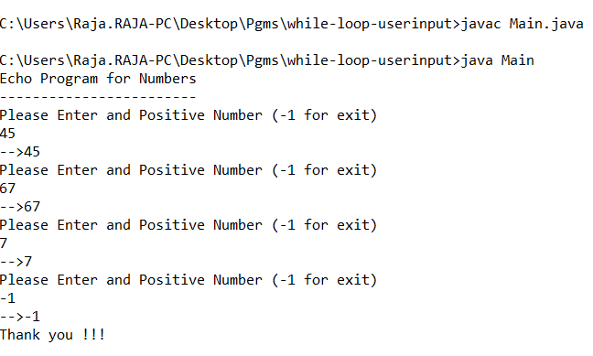
Output

Slide 14
DO-WHILE LOOP
It is also non deterministic loop.
A block of code executed repeatedly until the conditions remains satisfied.
It executes loop block at least once even the condition is not satisfied.
This is also known as exit control loop.

Slide 15
Syntax
do{
…
// Block of do-while loop
…
}while(Condition);

Slide 16
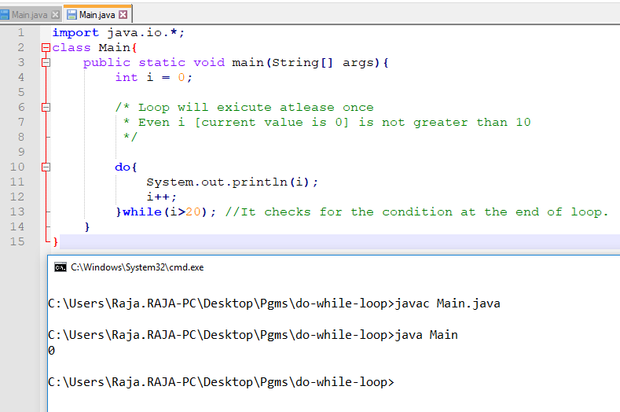
Example Do While

Slide 17
Problem
Extend the Calculator Program [Already done with switch case] for repeated inputs until user wants to exit.

Slide 18
Thank You
Rajasekaran S
Assistant Professor,
Department of Information Technology,
KGiSL Institute of Technology,
email: proffraja@gmail.com
Github:www.github.com/rajasekaranap

